Slide 1
C# Inheritance

Slide 2
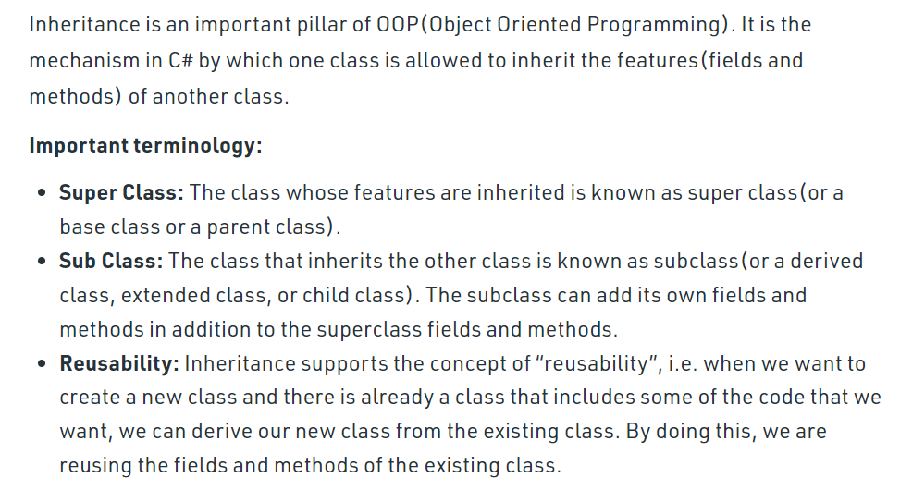
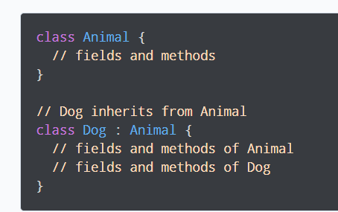
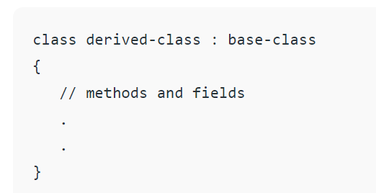

Slide 3
// C# program to illustrate the
// concept of inheritance
using System;
namespace ConsoleApplication1 {
// Base class
class GFG {
// data members
public string name;
public string subject;
// public method of base class
public void readers(string name, string subject)
{
this.name = name;
this.subject = subject;
Console.WriteLine("Myself: " + name);
Console.WriteLine("My Favorite Subject is: " + subject);
}
}
// inheriting the GFG class using :
class GeeksforGeeks : GFG {
// constructor of derived class
public GeeksforGeeks()
{
Console.WriteLine("GeeksforGeeks");
}
}
// Driver class
class Sudo {
// Main Method
static void Main(string[] args)
{
// creating object of derived class
GeeksforGeeks g = new GeeksforGeeks();
// calling the method of base class
// using the derived class object
g.readers("Kirti", "C#");
}
}
}

Slide 4
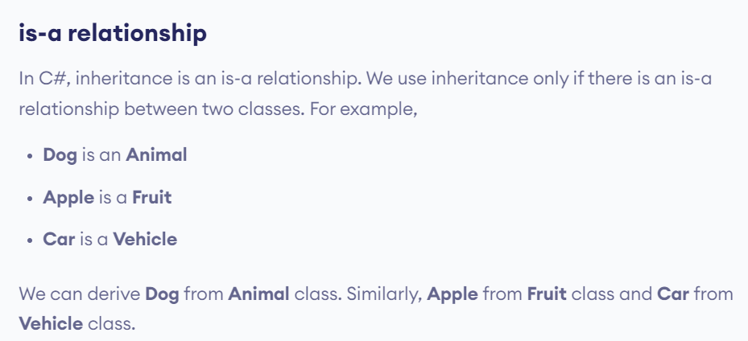

Slide 5
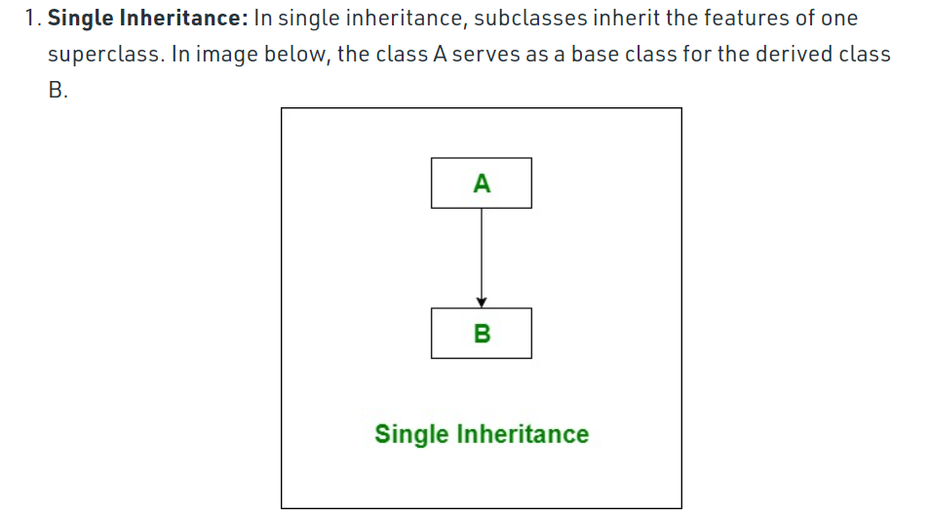
Text
Text

Slide 6
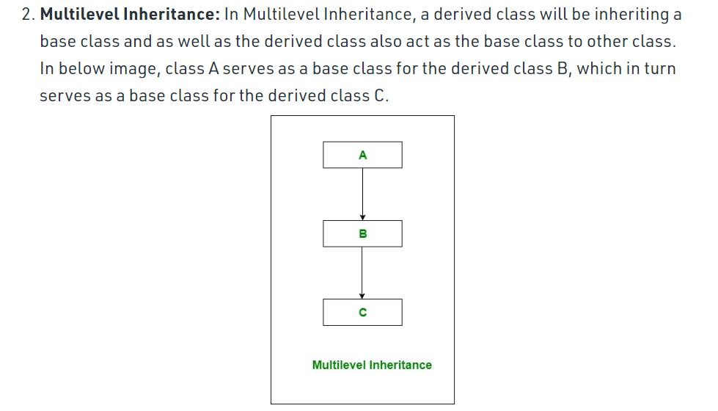
Text
Text

Slide 7
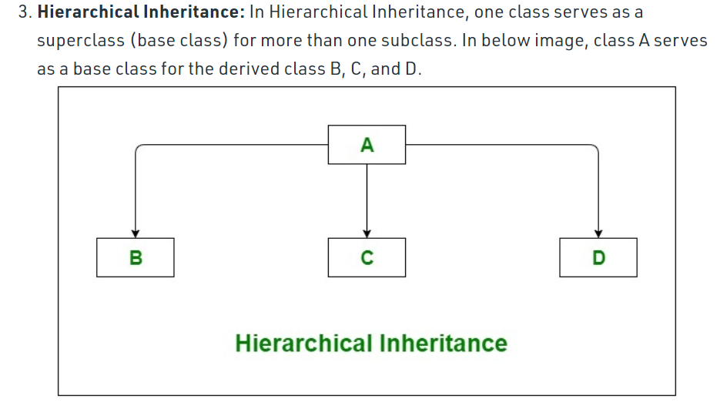
Text
Text

Slide 8
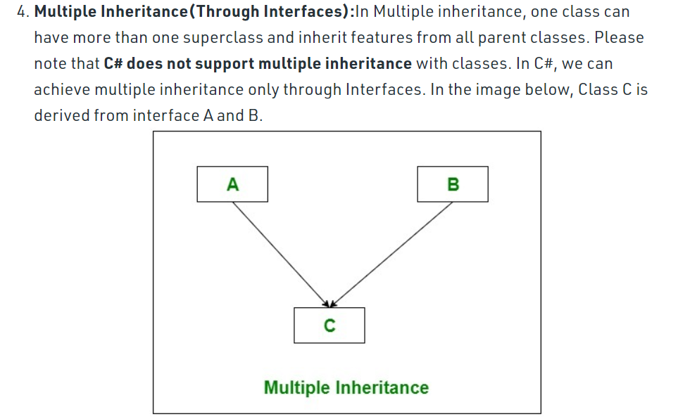
Text
Text

Slide 9
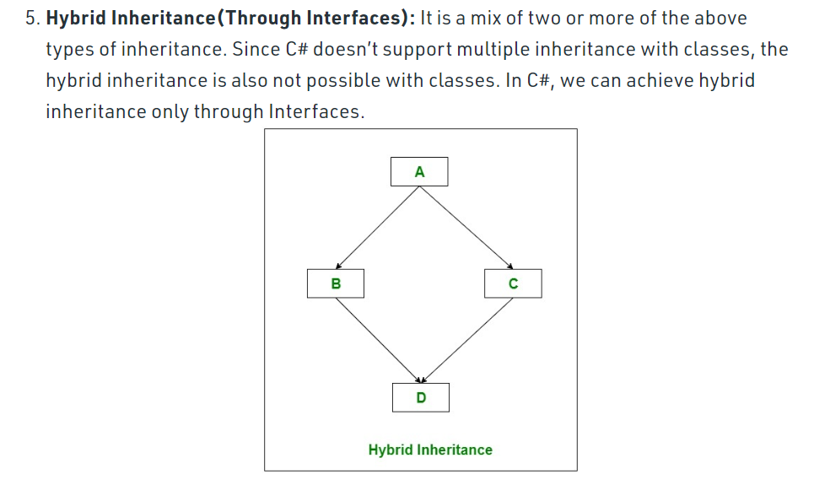
Text
Text

Slide 10
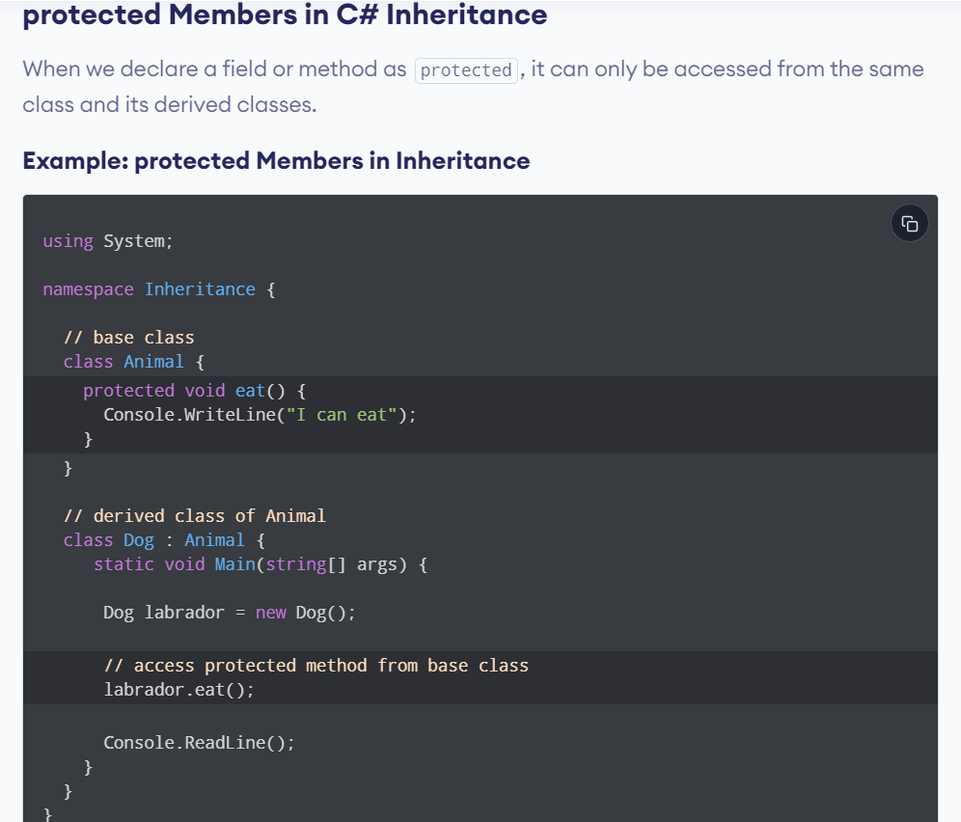
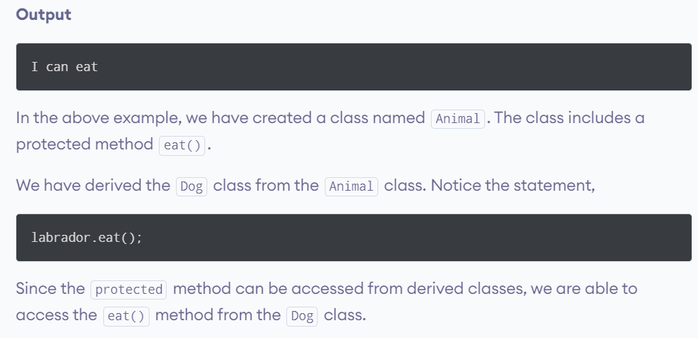

Slide 11
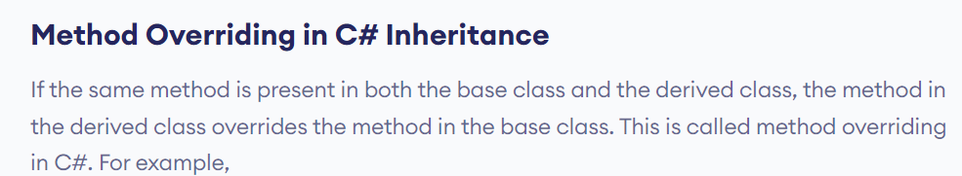
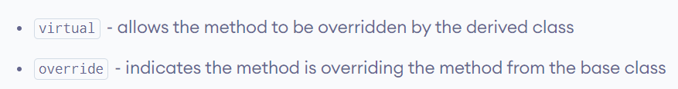
using System;
namespace Inheritance {
// base class
class Animal {
public virtual void eat() {
Console.WriteLine("I eat food");
}
}
// derived class of Animal
class Dog : Animal {
// overriding method from Animal
public override void eat() {
Console.WriteLine("I eat Dog food");
}
}
class Program {
static void Main(string[] args) {
// object of derived class
Dog labrador = new Dog();
// accesses overridden method
labrador.eat();
}
}
}

Slide 12
using System;
namespace Inheritance {
// base class
class Animal {
public virtual void eat() {
Console.WriteLine("Animals eat food.");
}
}
// derived class of Animal
class Dog : Animal {
// overriding method from Animal
public override void eat() {
// call method from Animal class
base.eat();
Console.WriteLine("Dogs eat Dog food.");
}
}
class Program {
static void Main(string[] args) {
Dog labrador = new Dog();
labrador.eat();
}
}
}

Slide 13
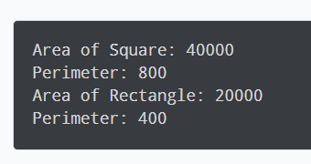
using System;
namespace Inheritance {
class RegularPolygon {
public void calculatePerimeter(int length, int sides) {
int result = length * sides;
Console.WriteLine("Perimeter: " + result);
}
}
class Square : RegularPolygon {
public int length = 200;
public int sides = 4;
public void calculateArea() {
int area = length * length;
Console.WriteLine("Area of Square: " + area);
}
}
class Rectangle : RegularPolygon {
public int length = 100;
public int breadth = 200;
public int sides = 4;
public void calculateArea() {
int area = length * breadth;
Console.WriteLine("Area of Rectangle: " + area);
}
}
class Program {
static void Main(string[] args) {
Square s1 = new Square();
s1.calculateArea();
s1.calculatePerimeter(s1.length, s1.sides);
Rectangle t1 = new Rectangle();
t1.calculateArea();
t1.calculatePerimeter(t1.length, t1.sides);
}
}
}

Slide 14
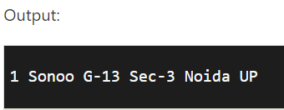
using System;
public class Address
{
public string addressLine, city, state;
public Address(string addressLine, string city, string state)
{
this.addressLine = addressLine;
this.city = city;
this.state = state;
}
}
public class Employee
{
public int id;
public string name;
public Address address;//Employee HAS-A Address
public Employee(int id, string name, Address address)
{
this.id = id;
this.name = name;
this.address = address;
}
public void display()
{
Console.WriteLine(id + " " + name + " " +
address.addressLine + " " + address.city + " " + address.state);
}
}
public class TestAggregation
{
public static void Main(string[] args)
{
Address a1=new Address("G-13, Sec-3","Noida","UP");
Employee e1 = new Employee(1,"Sonoo",a1);
e1.display();
}
}

Slide 15
Sources
https://www.geeksforgeeks.org/c-sharp-inheritance/
https://www.programiz.com/csharp-programming/inheritance#:~:text=In%20C%23%2C%20inheritance%20allows%20us,derived%20class%20(child%20or%20subclass)
https://www.javatpoint.com/c-sharp-aggregation#:~:text=C%23%20Aggregation%20(HAS%2DA%20Relationship,that%20represents%20HAS%2DA%20relationship.
Text

